Slide 1
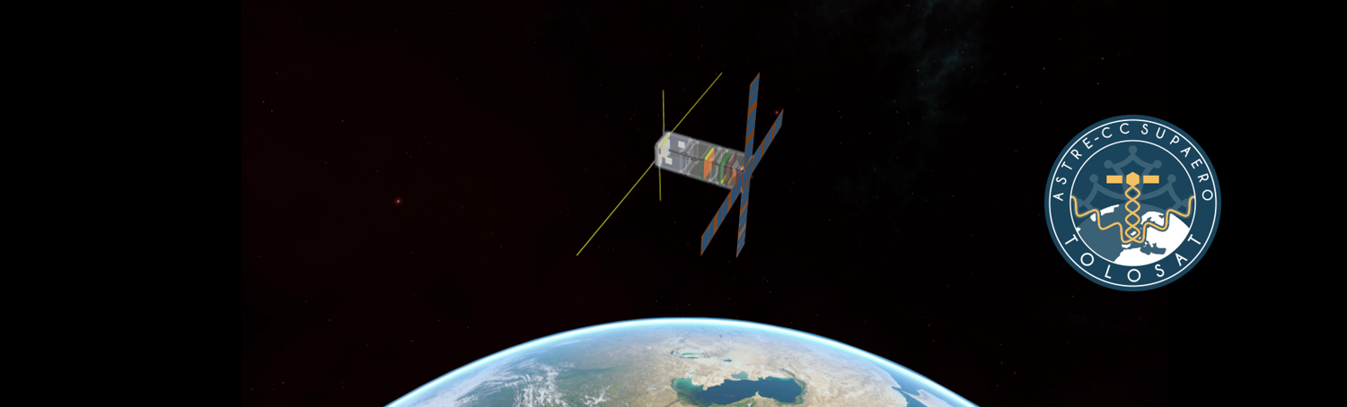
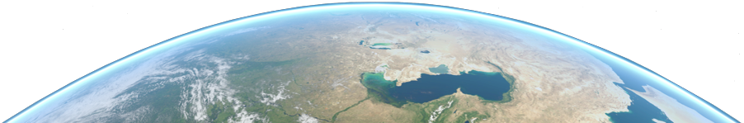
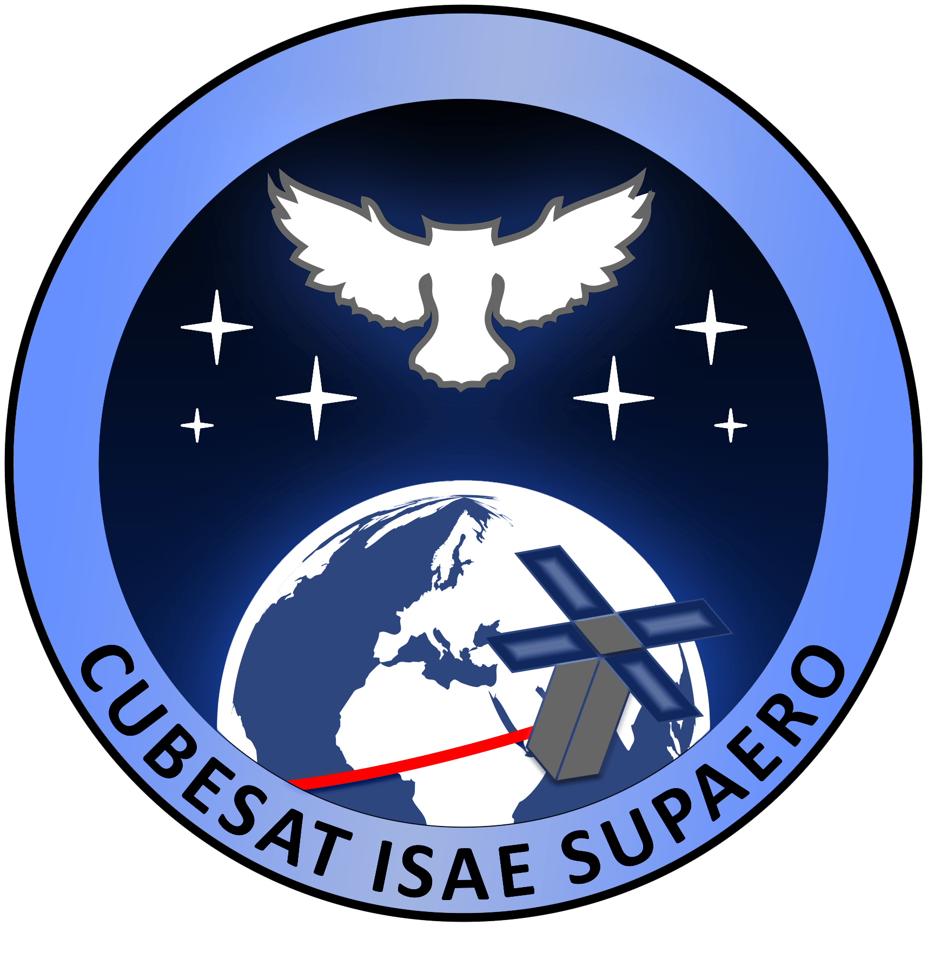

Mission Analysis in Python
An introduction to Tudatpy
Arnaud MULLER

Slide 2

Table of Contents
TOLOSAT
Introduction
What is Tudat & Tudatpy ?
Tudatpy Workflow
Coding with Tudatpy
Using the documentation
Useful Links
05/2021
Mission Analysis in Python
1

Slide 3
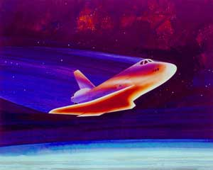
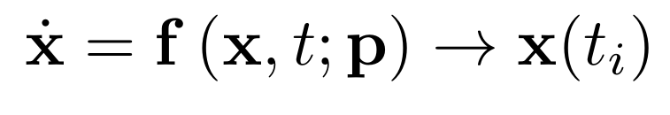
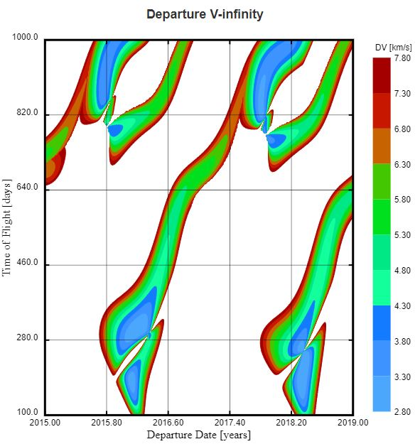
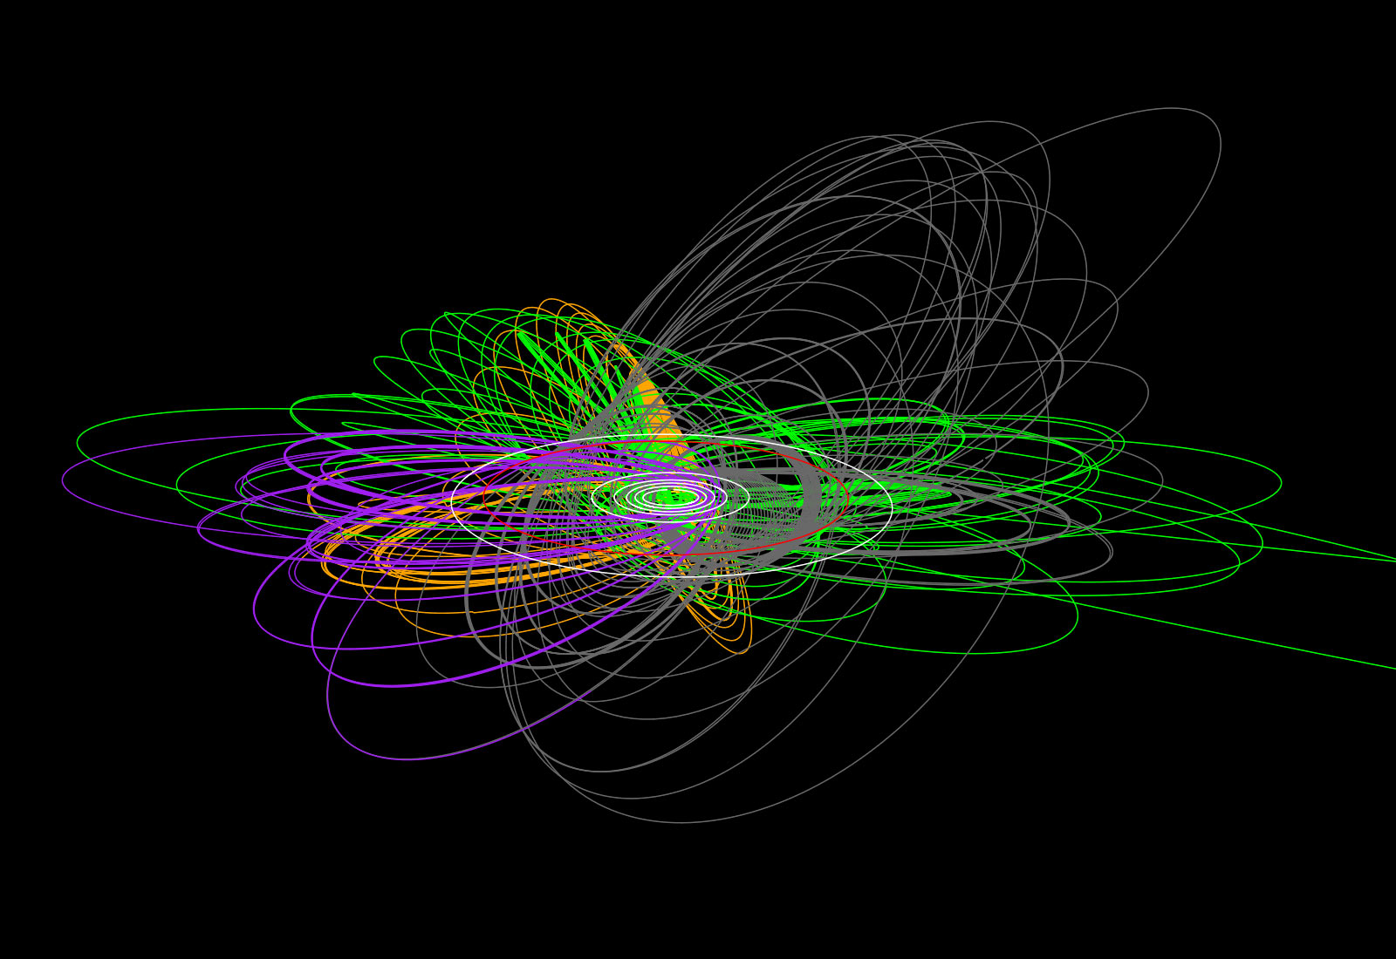
Introduction
TOLOSAT
Numerical Astrodynamics
Solving differential equations using a numerical integrator
Choosing which equations & models to use
Interpreting, verifying and applying the results
Mission Analysis in Python
2

Slide 4

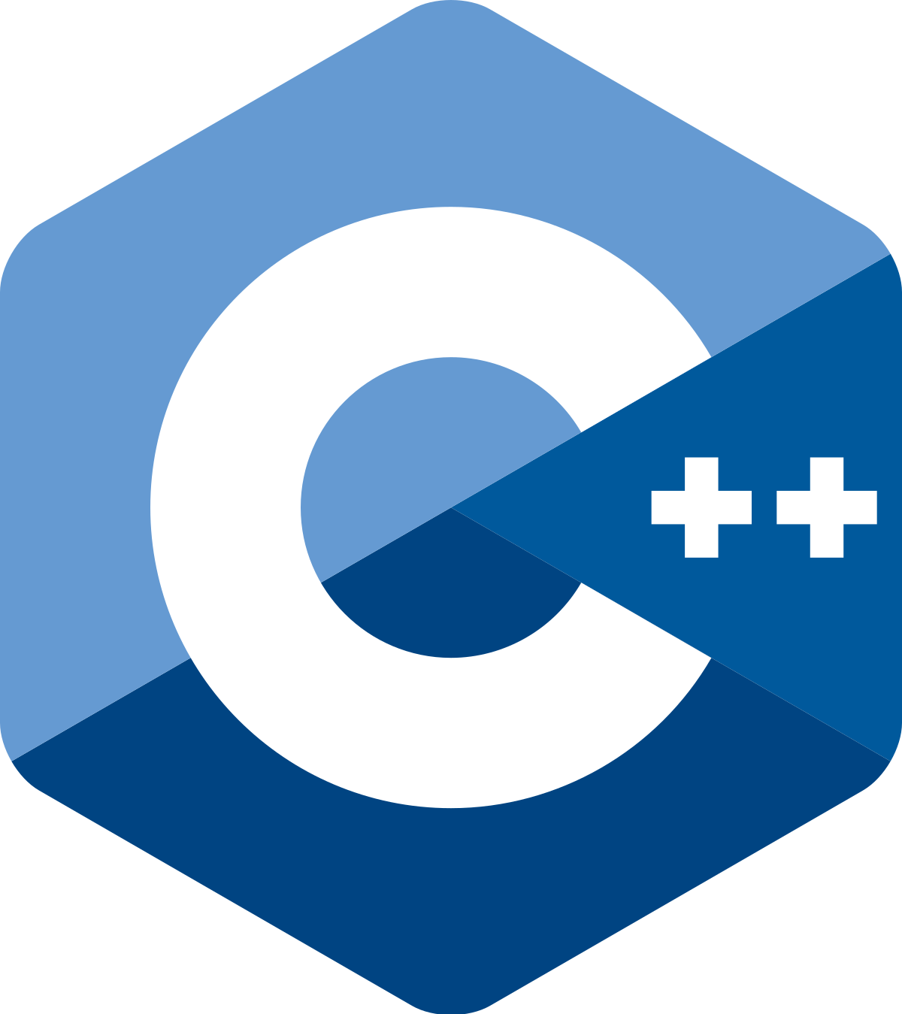
What is Tudat ?
TOLOSAT
Original project rationale
Validated and modular tool for TU Delft MSc and PhD students doing astrodynamics research
Validated: all code verified by unit tests
Modular: flexible setup for diverse applications (re-entry, ascent, transfer design, orbit optimization, …)
Prevent people from reinventing the wheel
→ As an open-source project, has become a more widely-used “software lab” for astrodynamics
05/2021
Mission Analysis in Python
3

Slide 5

What is Tudatpy ?
TOLOSAT
The best way to interact with Tudat
Tudat: core of the software written in C++, performs all the computations
Tudatpy: user-friendly Python interface, keeps the performance of C++
Plotting and analysis of the results can be done directly in Python
05/2021
Mission Analysis in Python
4

Slide 6
Tudatpy Workflow
TOLOSAT
Input Settings
Output Variables
Dependent variables (state in other frames, position of other bodies, etc.)
Acceleration settings
Forces for each S/C
Central Bodies
Earth/Sun/... for each S/C
Propagator settings
Type (Translational, etc.)
Initial state
Bodies to propagate
Termination condition
Body settings
Planetary bodies
Global frame
Acceleration models
Bodies to propagate
Central bodies
Environment
Bodies
Spacecraft body & specs
Dynamics simulator
Type (Single Arc, etc.)
Integrator settings
Type (RK4, etc.)
Start epoch
Step size
Interfaces
Aero, radiation, etc.
Input data (CSV files)
Start/end, step size, spacecraft specs
Mission Analysis in Python
5

Slide 7
Tudatpy Workflow
TOLOSAT
Input settings
Environment
Dynamics simulator
Results
Seconds since J2000
Cartesian states
Dependent variables
Tudatpy (Python interface)
Input & Output settings
Tudatpy (Python interface)
Input & Output settings
Tudat (C++)
Propagation & other calculations
Mission Analysis in Python
6

Slide 8
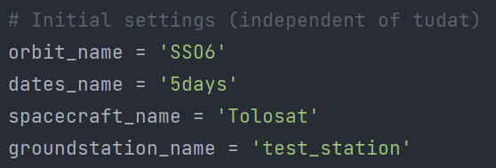
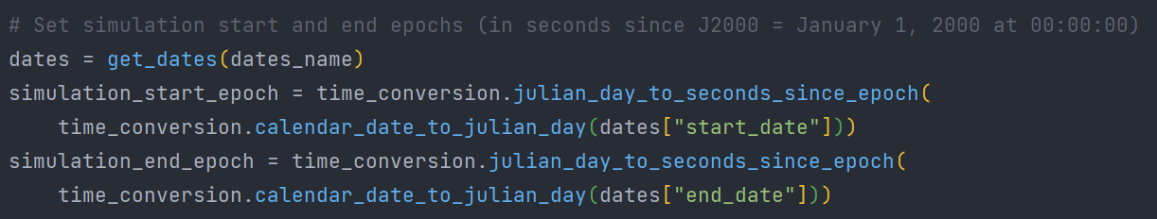
Coding with Tudatpy
TOLOSAT
Select input data
Set start & end dates
Mission Analysis in Python
7

Slide 9
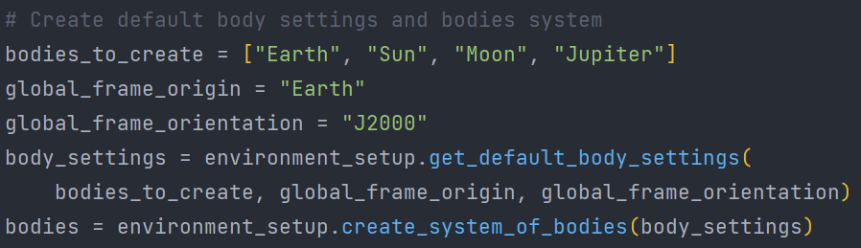
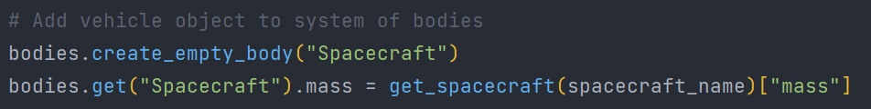
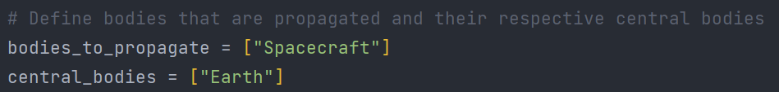
Coding with Tudatpy
TOLOSAT
Create planetary bodies & set frame
Add spacecraft
Define bodies to propagate with respect to which body
Mission Analysis in Python
8

Slide 10
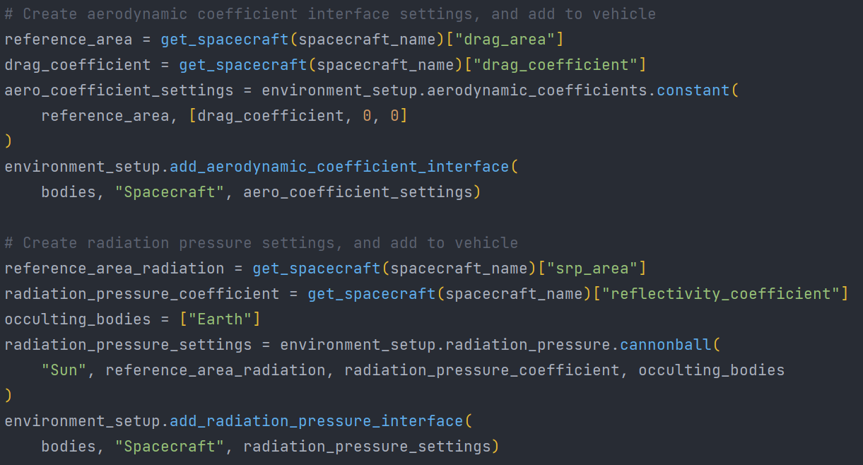
Coding with Tudatpy
TOLOSAT
Create aerodynamic & radiation interfaces
Mission Analysis in Python
9

Slide 11
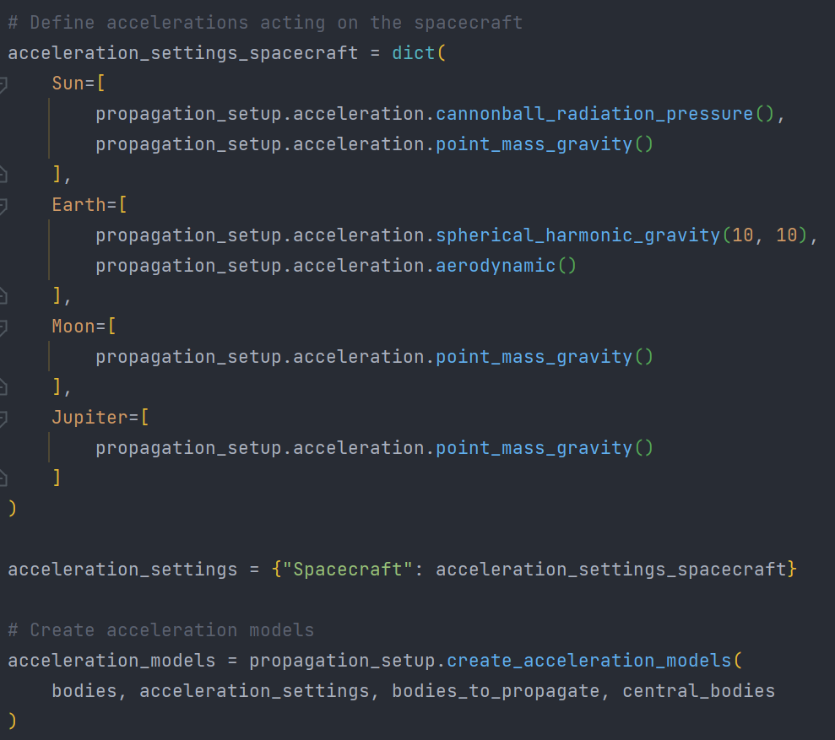
Coding with Tudatpy
TOLOSAT
Choose acceleration settings
Mission Analysis in Python
10

Slide 12
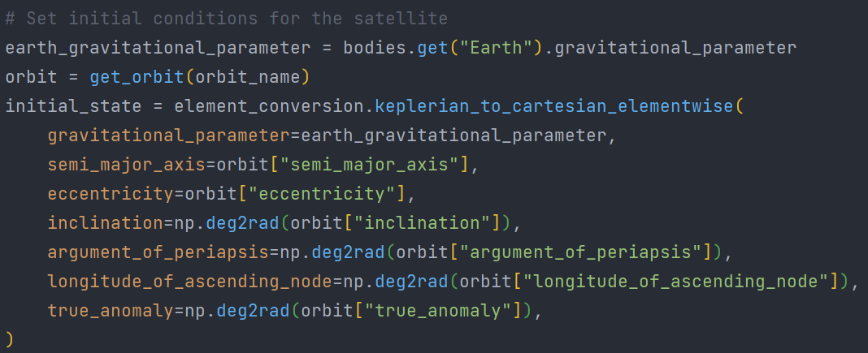
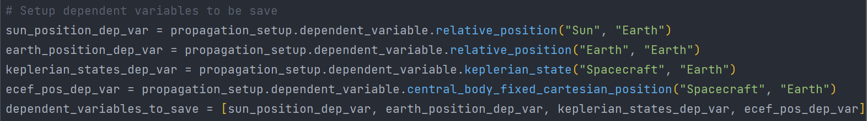
Coding with Tudatpy
TOLOSAT
Set initial state of the spacecraft
Choose dependent variables to export (on top of cartesian states)
Mission Analysis in Python
11

Slide 13
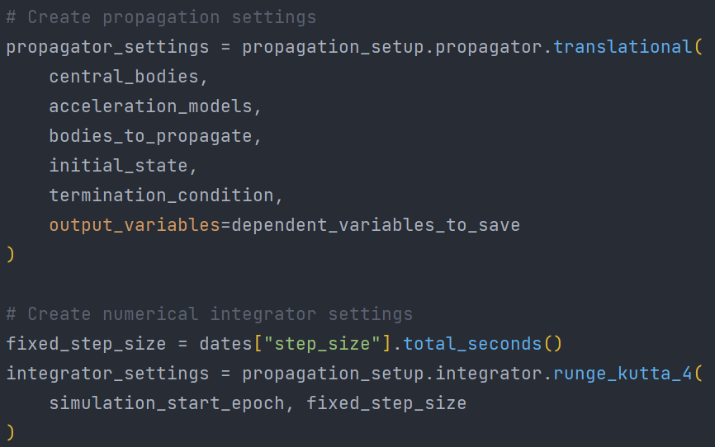
Coding with Tudatpy
TOLOSAT
Create termination condition
Create propagator & integrator settings
Mission Analysis in Python
12

Slide 14
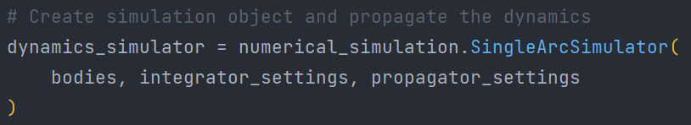
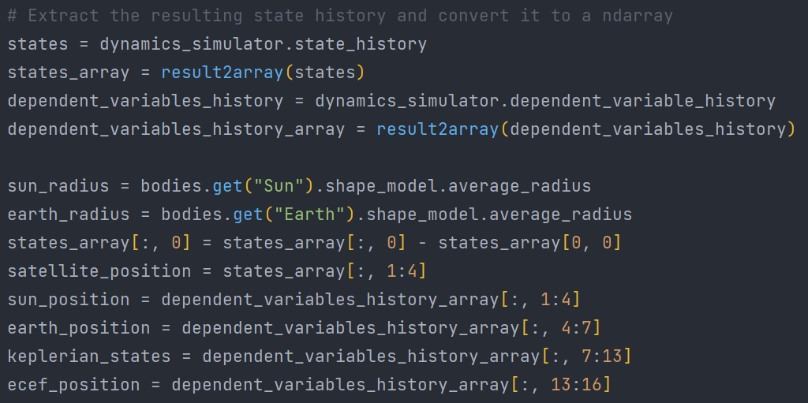
Coding with Tudatpy
TOLOSAT
Assemble dynamics simulator → STARTS PROPAGATION
Extract results
Mission Analysis in Python
13

Slide 15
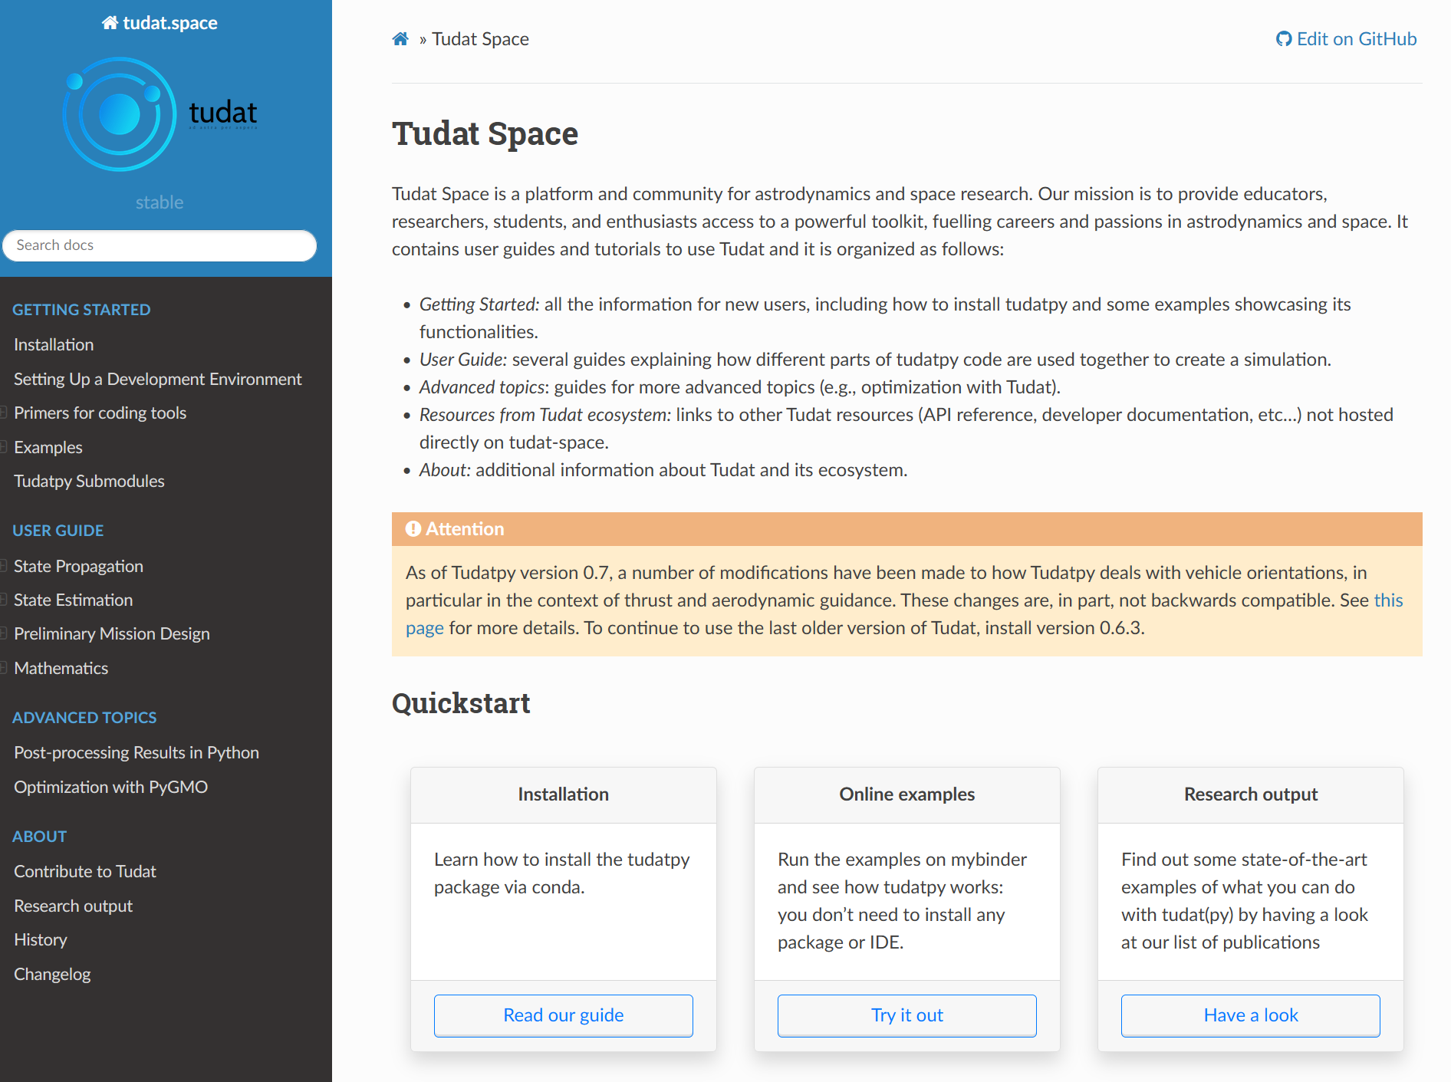
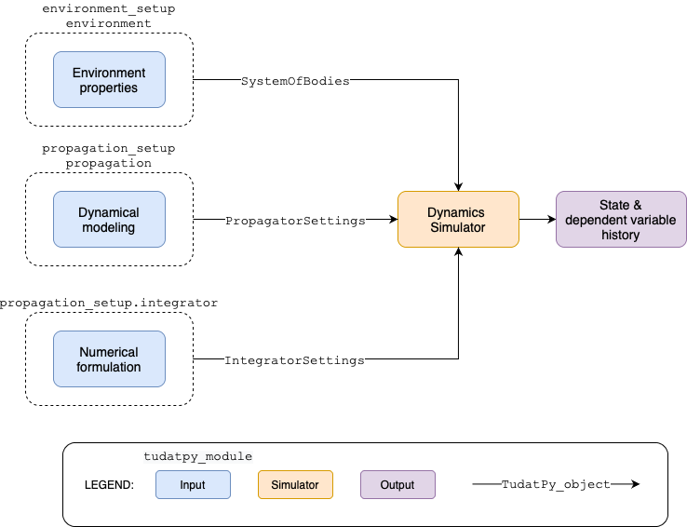
Using the documentation
TOLOSAT
Tudat documentation
Useful to understand the intricacies of Tudat and find code snippets.
Mission Analysis in Python
14

Slide 16
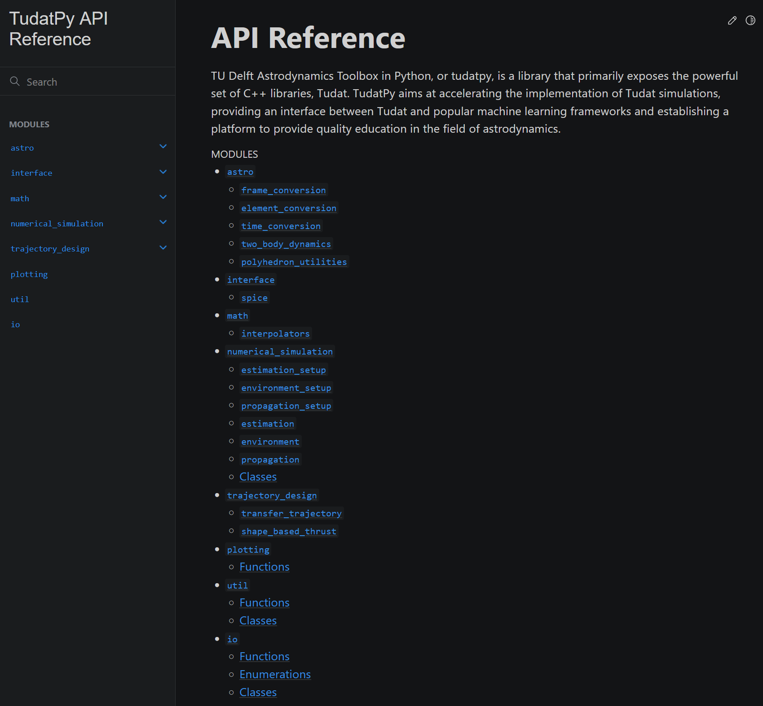
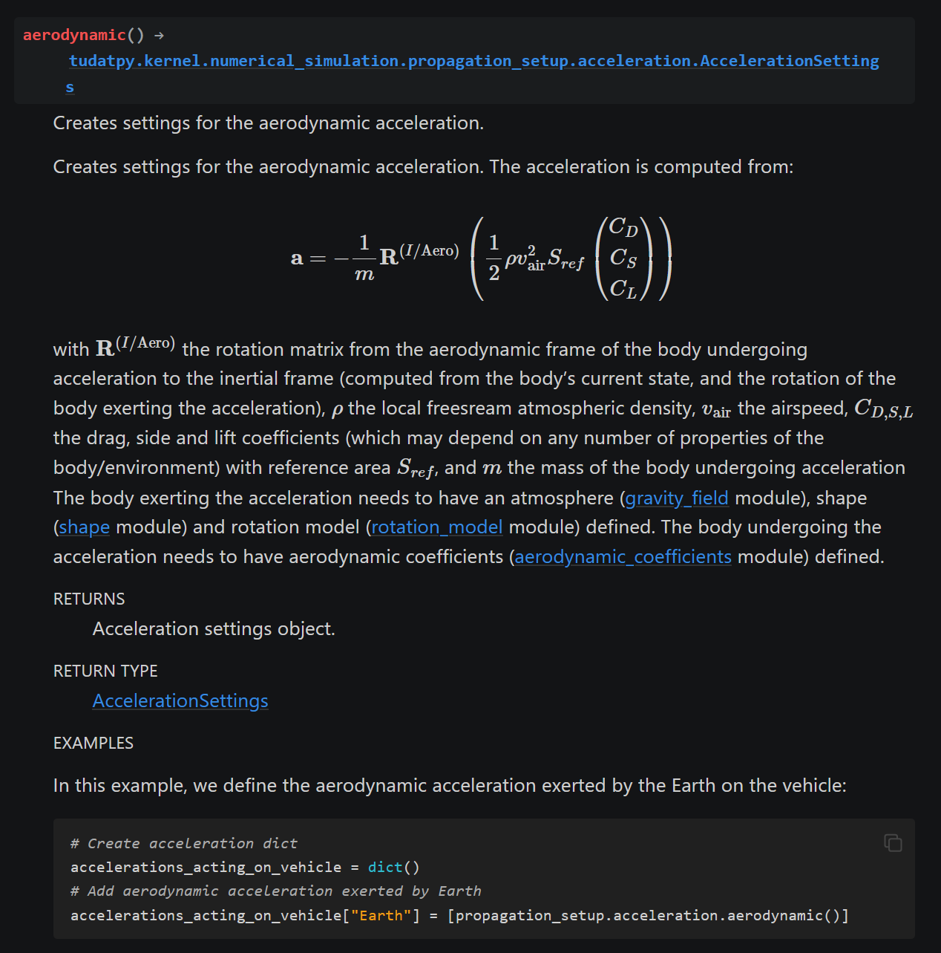
Using the documentation
TOLOSAT
Tudatpy API reference
Useful to see exactly how to use the Tudatpy interface and what features are available.
Mission Analysis in Python
15

Slide 17
References & Links
Dominic Dirkx, AE4868 Numerical Astrodynamics, TU Delft (D.Dirkx@tudelft.nl)
TU Delft Astrodynamics Toolbox (TUDAT) https://docs.tudat.space/en/stable/
Tudat documentation https://docs.tudat.space/en/stable/
Tudatpy API reference https://py.api.tudat.space/en/latest/
Arnaud MULLER

